Slide 1
Real-Time communication guarantees OVER Mote Runner
Jonathan Derrick
Supervisor: Leandro Soares Indrusiak

Slide 2
SCOPE OF THE PROJECT AND THIS PRESENTATION
Literature review into WSN protocols/platforms/issues
Specification, Optimization, Analysis and Integrity Assurance of a new Wireless Sensor Network (WSN) protocol
Specification: of the protocol’s communicating methodologies
Optimization: to reduce the idle time of the network
Analysis: production of response time models & validating them
Integrity Assurance: of how well the protocol handles external interference
Conclusions and suggested further work from results
Notes:
Breaking down this presentation into the path followed by the report, we’ll begin with a comprehensive review into WSN protocols/execution platforms and the issues they face in day-to-day operation
An alternate title for this project is…. Which is broken down into:
- Defining our own protocol and its communication policies - two vastly different options as we’ll see in the li review shortly which we’ll take inspiration from

Slide 3
An introduction to wsns
Wireless Sensor Networks
Large interconnected network of resource constrained devices (motes) used for real-time environment monitoring [ref]
Need to be able to prevent the influence of
External interference (intentional and unintentional)
Internal interference (single transmission at a time)
Protocols
IEEE 802.15.4 used as Physical layer
Beacon Enabled or Non-Beacon Enabled
Several sets of frequencies to transmit of (channels)

Slide 4
TWO DIFFERENT PROTOCOLS
Beacon ENABLED:
Wireless HART
NON-BEACON ENABLED:
ZIGBEE
Time Division Multiple Access
Superframes and timeslots
Centralized network manager
Channel Hopping & Blacklisting
Inherent Internal Interference Managing
External interference managed
Carrier Sense Multiple Analysis with Collision Detection
Transmit when you’re ready and the channel is free
Back off factor
No channel hopping
Doesn’t respond to external interference

Slide 5
EXEUCTION PLATFORMS & RESPONSE TIME ANALYSIS
Variety of virtual machines/operating system choices providing abstraction from the hardware []
TinyOS
C-like language, nesC
Mote Runner
Strictly-typed HLLs supports (Java and C# mainly)
Simulator
Eclipse IDE plugin for debugging
(Briefly) Considered fixed priority scheduling and response time analysis

Slide 6
data transfer specification
Defined 10 randomly generated data transfers between 5 nodes (A to E) as a case study for our analysis
Simplifying assumption about periods
No transfer needs to occur before all other have completed
Simplifying assumptions about topology (all in range)
Devices only need to transmit/receive data
Implicit Deadlines
ID | Source | Dest. | Size (bytes) | Priority
1 | B | E | 43 | 1
2 | A | D | 33 | 2
3 | C | E | 24 | 3
4 | B | C | 12 | 4
5 | D | B | 45 | 5
6 | D | C | 25 | 6
7 | B | E | 14 | 7
8 | A | B | 11 | 8
9 | D | A | 18 | 9
10 | B | C | 32 | 10

Slide 7
DESIGN & IMPLEMENTATION
Choice of execution platform – Mote Runner
Based off WirelessHART – transmission determinism
Definition of LikeWHART
Beacon Enabled – Superframe of timeslots
Timer-based interrupts
Packet Acknowledgment to ensure delivery
Not implemented due to lack of documentation
Channel Hopping (every superframe) - next channel broadcast by the Network Manager

Slide 8
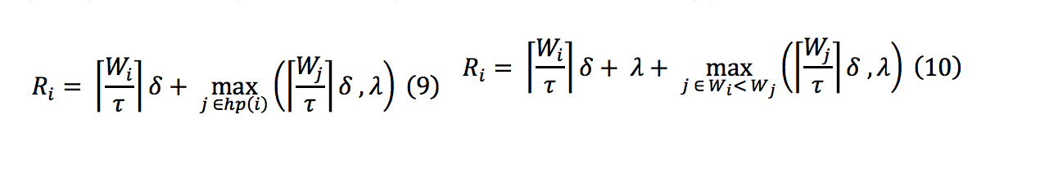
SCHEDULING + RESPONSE TIMES
Smallest Transfer First (STF) vs Fixed Priority Scheduling (FPS)
Response time models produced using previous assumptions
Synchronisation constant
Setup time for each superframe

Slide 9
ANALYSIS METHODOLOGIES
Simulator
Logger outputs acting as packet acknowledgment
Software model, doesn’t emulate the hardware
Optimization: two devices with network manager (NM)
Minimization of idle time
Smallest timeslot found for 10, 20, 30, 40, 50 bytes
Synchronisation Constant: single node with NM
Integrity: NM + two network devices + rogue device
Increased rate of channel changing
Response Times: Computed & measured using specification

Slide 10
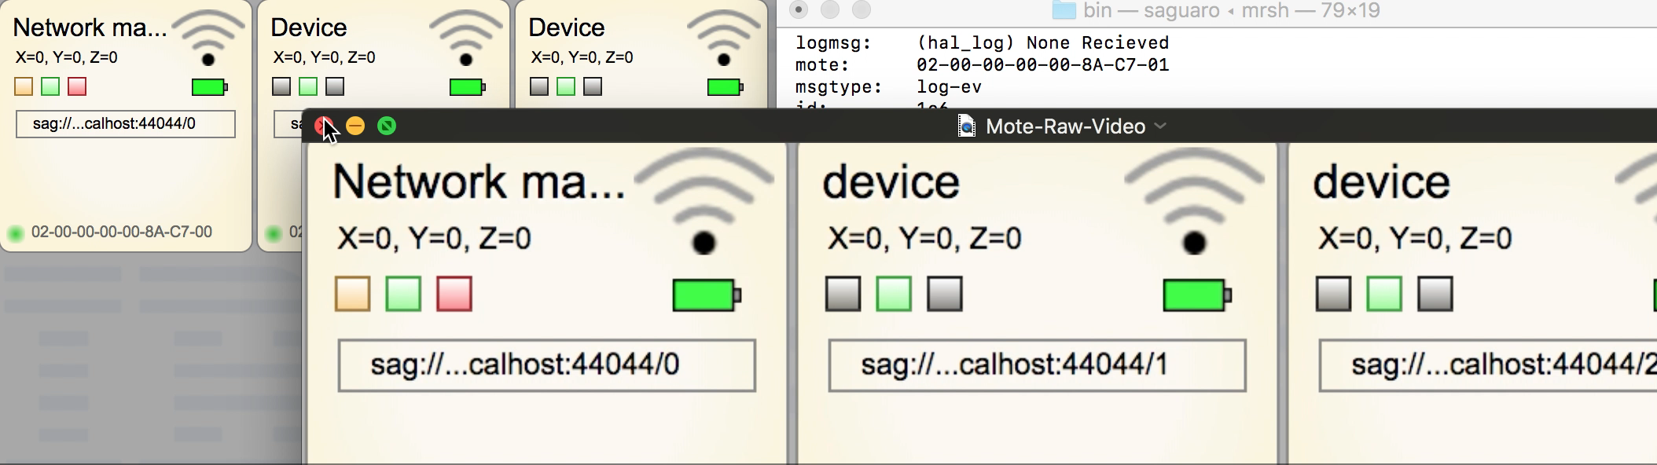
DEMONSTRATION

Slide 11
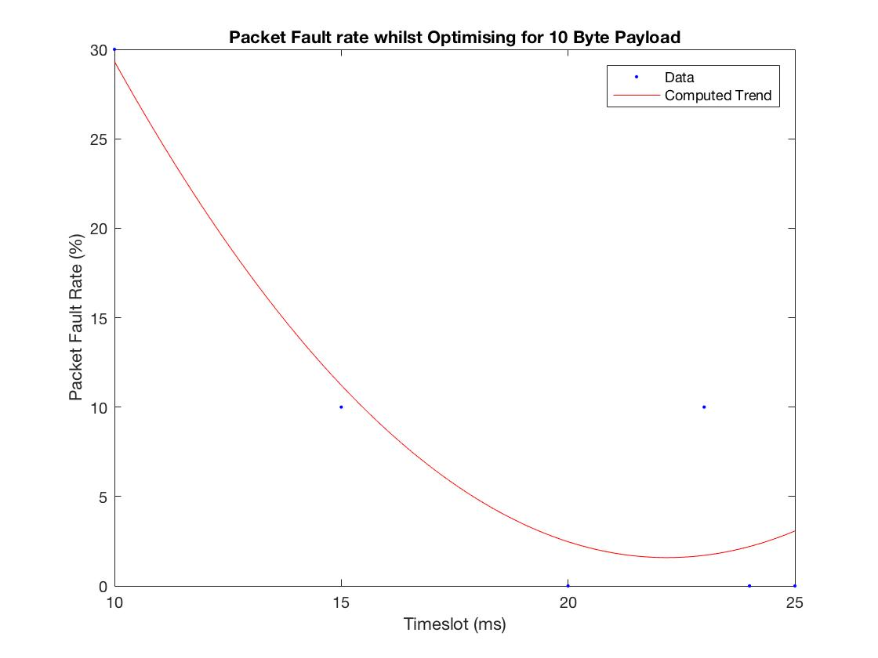
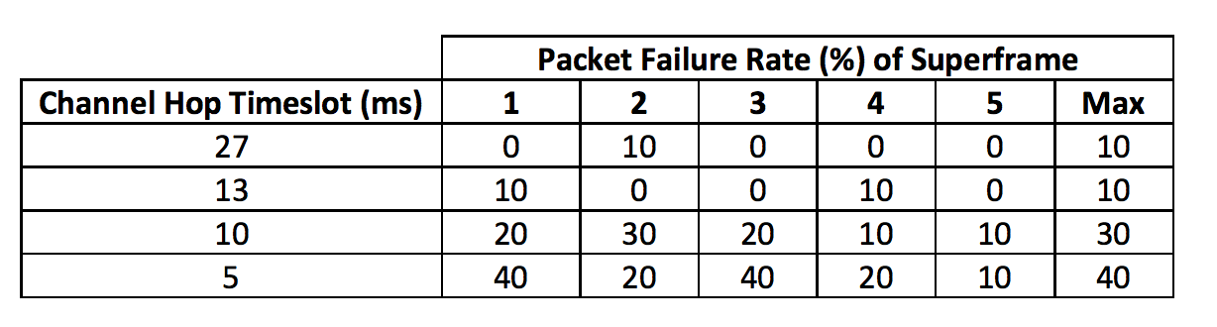
RESULTS
Optimal timeslot growth slower than expected
10: 24ms 20: 25ms 30: 25ms 40: 27ms 50: 27ms
Large growth in packet fault rate
Synchronisation constant found to be 25ms
Slight fluctuations but down to measuring apparatus
Response times computed and real values recorded
Model holds up well, averages less than or equal to proposed ones
STF has a better average response time
Integrity analysis showed poor management of external interference as rate of change increased

Slide 12
CONLCUSIONS
LikeWHART is a slow WSN protocol (25ms timeslot vs 10ms for WirelessHART)
LikeWHART doesn’t handle external interference at all – it just drops packets (lack of packet acknowledgements)
Synchronisation constant introduced and, is constant
Need to reduce this, as large as a timeslot
Response time models proved to be correct
LikeWHART needs a lot more work to be usable

Slide 13
Further work
LikeWHART limited by execution platform severely
Near Future (weeks)
Conduct more analysis (remove assumptions - more complex)
Move to the physical motes
Not enough time do much more
Considerable Future (months)
Change execution platform (for packet acknowledging)
Extend LikeWHART – multi-hop network, larger topologies, per transmission channel hopping.

Slide 14
Questions?

